Slide 1





Slide 2


Learn to create impactful cover letters for job applications
Crafting Your
Cover Letter:
A Guide

Slide 3

Mastering Your Cover Letter
Here’s what we’ll cover in today’s presentation:
Purpose of a cover letter
Key steps for writing a cover letter
Tips for successful cover letters
Common mistakes to avoid
Examples of effective cover letters

Slide 4
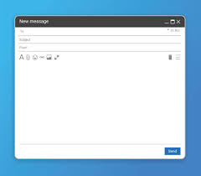
When you send a CV, do you attach something with it, or do you send the email empty?

Slide 5
Understanding the Purpose of a Cover Letter
A cover letter serves as your first impression to potential employers. It highlights your interest in the role, showcases relevant skills, and motivates the reader to consider you for an interview.
A well-crafted cover letter can set you apart from other candidates.

Slide 6

Highlighting Relevant Skills
Showcase your top qualifications that align with the job description. Use specific examples to demonstrate your qualifications and experience.
Crafting an Effective Cover Letter
Motivating the Reader
Inspire the hiring manager to consider you as a strong candidate.
Call to Action
Encourage the reader to invite you for an interview and discuss further.

Slide 7


Key Steps:
Reading the Job Description Thoroughly
Understanding the job requirements is crucial.
Customization
Tailor each letter to the job description for maximum impact.

Slide 8
Tips for Success:
1. Maintaining a Professional Tone
Keep your language respectful and appropriate.
A professional tone reflects your seriousness about the position. Use formal language, avoid slang, and tailor your writing style to match the company's culture. This approach demonstrates your attention to detail and respect for the employer.

Slide 9

Tips for Success:
2. Proofreading Meticulously
Ensure your cover letter is free from errors and clearly conveys your message.
Ask Someone for Review
A second pair of eyes can help catch overlooked mistakes and improve clarity.
Check Grammar and Spelling
Utilize tools or resources to ensure professional tone and accuracy in your writing.

Slide 10
Cover letter vs. CV
Video Time
Watch the video .
What is the difference between a CV And a Cover Letter?
What do we write in a cover letter?
https://youtu.be/E_kWz09Etcc

Slide 11


Slide 12
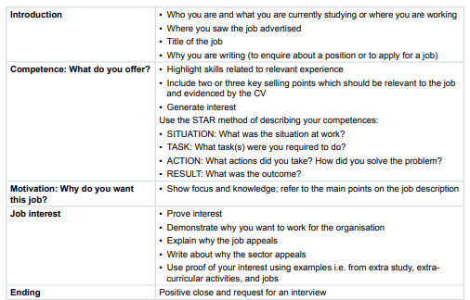
How to write a cover letter

Slide 13


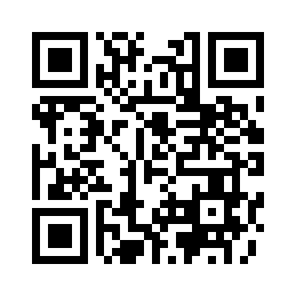
Useful expressions Play the game
https://wordwall.net/resource/70272728

Slide 14
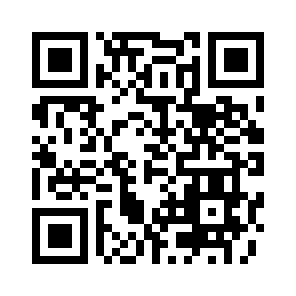
Play the game
https://wordwall.net/resource/66726978
Notes:
Teachers may skip this game if they don’t have enough time

Slide 15
Let’s analyze this cover letter
Dear Hiring Manager,
I am writing to express my keen interest in the Penetration Testing position at your company. With a background in web development and a growing expertise in cybersecurity, I am eager to apply my technical skills and problem-solving abilities to contribute effectively to your team.
Previously, as a Web Developer at Bardy, I played a key role in building and maintaining responsive applications, implementing frontend features based on user needs, and optimizing performance. Additionally, my work as a Freelance Full-Stack Developer has strengthened my ability to design and secure RESTful APIs, conduct security audits, and implement authentication mechanisms.
🔹 Example (STAR Method): While working on a client’s e-commerce platform, our team discovered a major security vulnerability in the payment gateway just days before launch (Situation). I was tasked with identifying and resolving the issue under tight time constraints (Task). I immediately conducted a penetration test, traced the vulnerability to an insecure API endpoint, and implemented a secure token-based authentication system (Action). As a result, we eliminated the vulnerability before release, safeguarded customer data, and gained positive feedback from both the client and management (Result).
Beyond development, I am deeply passionate about cybersecurity and penetration testing. Currently, I am expanding my expertise in ethical hacking, vulnerability assessment, and network security. My graduation project, an AI-Powered Security Solution for Web Applications, reflects my commitment to building innovative, security-driven systems by integrating machine learning for threat detection.
I am eager to bring my technical skills, problem-solving mindset, and security-conscious approach to your organization. I would welcome the opportunity to discuss how my experience and passion align with your needs.
Thank you for your time and consideration. I look forward to your response.
Sincerely, [Your Name]

Slide 16
Task
Write a cover letter to attach to the CV you created before.

Slide 17


